Slide 1
Pancasila as the Source of Character Education Session 01
Course : CB Pancasila
Effective Period : 2018

Slide 2

Student will be able to explain Pancasila as the source of character education

Slide 3
The Importance of Character Education
In the college, character education emphasizes the using of freedom aspect.
It is important to help students gain an adequate understanding and being able to use their freedom of choice in a morally justified action.
The form of character education in college that is doing the study, critical reflection and systematic (a discussion of the cases related to the issue of character).
Perform activities related to the appreciation of the values that increasingly influence the attitudes and actions.

Slide 4
Science education needs to be coupled with character education.
Students as a potential human being and future leaders, it is important to have good character
There are many bad actions committed, including by people who are educated and have a high office.

Slide 5

Noble Values of Pancasila
There are 5 great values of Pancasila
Its become capital, power, means of unifying the nation

Slide 6
Character Education Based on Pancasila
- Pancasila values are the crystallized indigenous values of Indonesians
- The values of Pancasila should be conserved and maintained as the values of Indonesians

Slide 7
Character Education Based on Pancasila
- Pancasila values should be explored and implemented in modern era
- Pancasila should be used as the source for building character

Slide 8
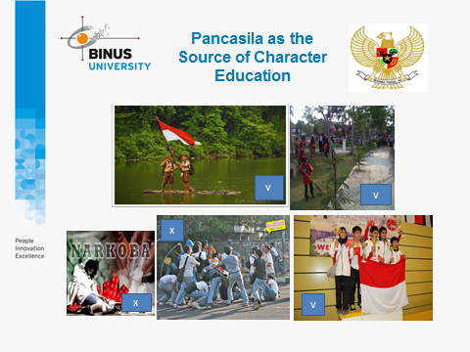

Slide 9
Discussion
What do you think about the application of the five main character values: religious, nationalist, self help, mutual, and integrity as the implementation of strengthening character education?

Slide 10
Case Study
Read the article based on the following link …. And give your opinion
Pendidikan Karakter Berbasis Pancasila
http://edukasi.kompas.com/read/2010/12/06/11371340/Pendidikan.Karakter.Berbasis.Pancasila

Slide 11
Question and Answer
?

Slide 12
References
Tim Penulis CB: Pancasila (2014). Diktat Kuliah Character Building: Pancasila. Jakarta: Binus University: CBDC.
Video: Introduksi Pancasila sebagai Sumber Nilai bagi Pendidikan Karakter oleh Fios Frederikus (2014) Jakarta.
Gambar Pancasila: www.anneahira.com
Gambar Learning Objective: https://student-learning-objectives.wikispaces.com/2+-+Writing+the+SLO
gambar gotong royong: http://www.radarbangka.co.id/berita/detail/belitong/33378/kwarran-manggar-libatkan-pelajar-gotong-royong.html
Gambar pramuka: http://dewiarisna.blogspot.co.id/2015/0/pengertian-tujuan- dan-nilai-pendidikan.html
Gambar bahaya narkoba: http://ikmunand15kelompok2.blogspot.co.id/2015/09/penyalahgunaan-narkoba-di-kalangan.html
Gambar tawuran remaja: http://remaja.suaramerdeka.com/2016/08/24/kenapa-harus-tawuran-kalau-berkawan-lebih-nyaman/
Gambar berprestasi : http://aureldevy.blogspot.co.id/2013/11/prestasi-anak-bangsa-di-dunia.html
Case Study: http://edukasi.kompas.com/read/2010/12/06/11371340/Pendidikan.Karakter.Berbasis.Pancasila

